Slide 1

Socioeconomic Status & Survival
Jasmin Dönicke
Max Jaber
Lisa Kannenberg
Andrei Kachmazov

Slide 2


Slide 3
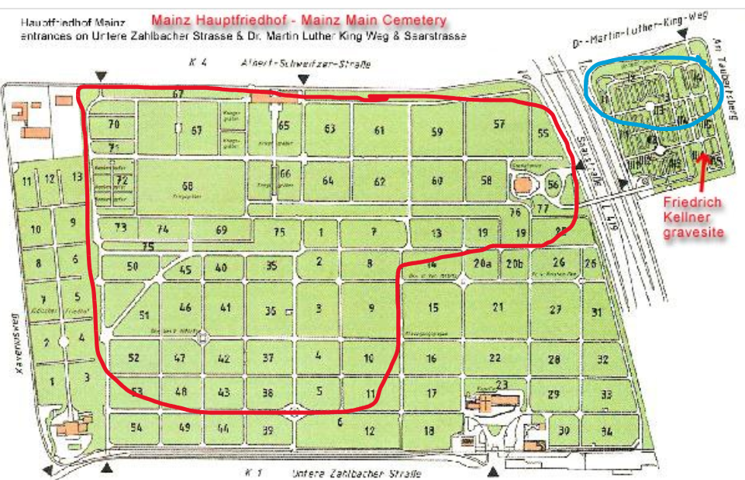
Research Area
Area of Grave Plots research highlighted in red
Area of Urn Columbariums research highlighted in blue

Slide 4


Sample Size Calculation
Number of events required in both groups
Assuming a HR of 1.5, we need at least 128 people in both groups
Resulting in a minimum sample of 256 total

Slide 5
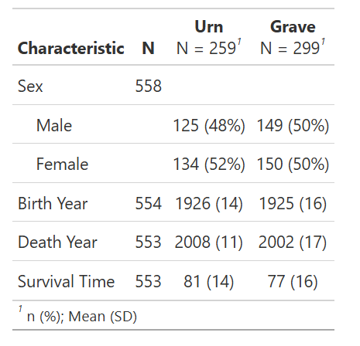
Descriptive Analysis
Mean & SD

Slide 6
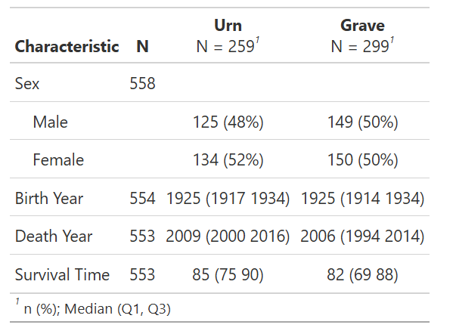
Descriptive Analysis
Median & IQR

Slide 7
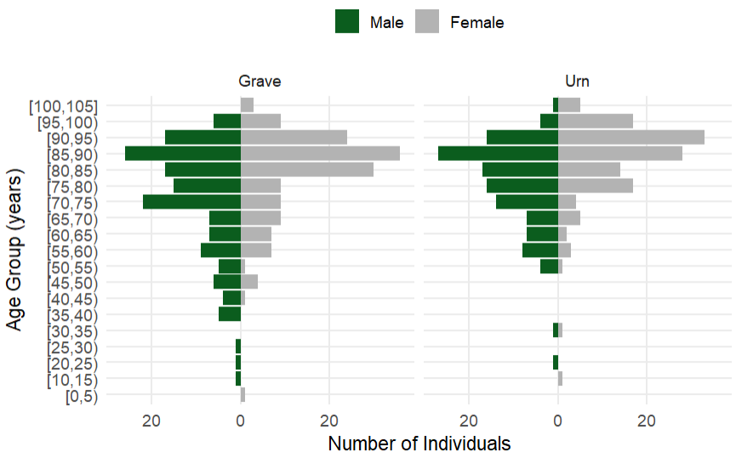
Descriptive Analysis . Age-Pyramid by Burial-Type

Slide 8
Inference Statistics
Grave VS. Urn
HR = 1.30
95% CI: 1.10 to 1.53
p = 0.0026
Female VS. Male
HR = 0.60
95% CI: 0.51 to 0.71
p < 0.001
When controlling for sex, people with graves have a 30% higher hazard of death compared to urn burials. This means they die earlier on average.
Women have a 40% lower hazard of death than males. This means they live longer.

Slide 9
Birth Cohort
Urn burials show longer survival across cohorts, but differences are only significant in the inter-war birth group. No clear effect in pre-WWI or post-WWII cohorts, likely due to smaller sample sizes.
Birth Cohort | HR (95% CI) | p-value | n
Before WW I | 1.33 (0.89, 1.98) | 0.16 | 105
Between WW I and WW II | 1.41 (1.14, 1.75) | 0.002 | 351
After WW II | 1.09 (0.71, 1.66) | 0.70 | 90

Slide 10
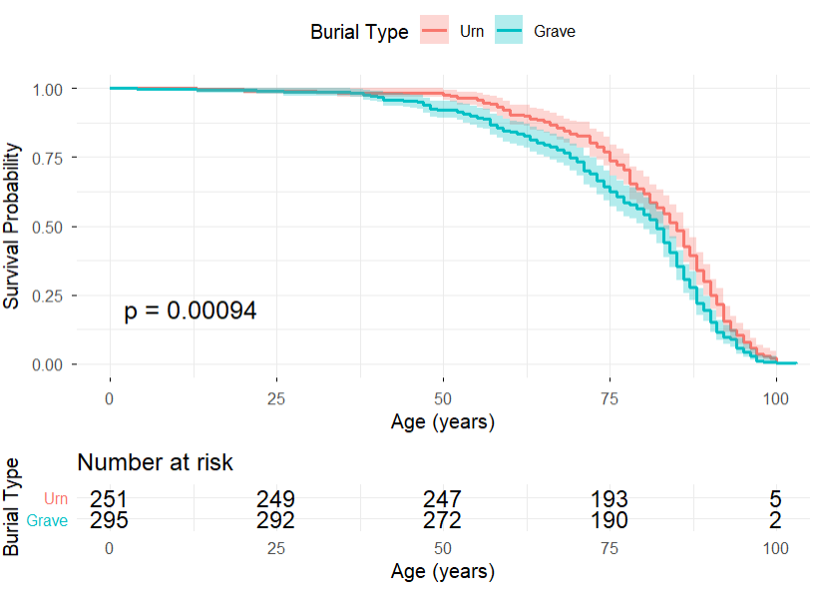
Survival Curve
Note: The survival curve is not adjusted for sex.

Slide 11
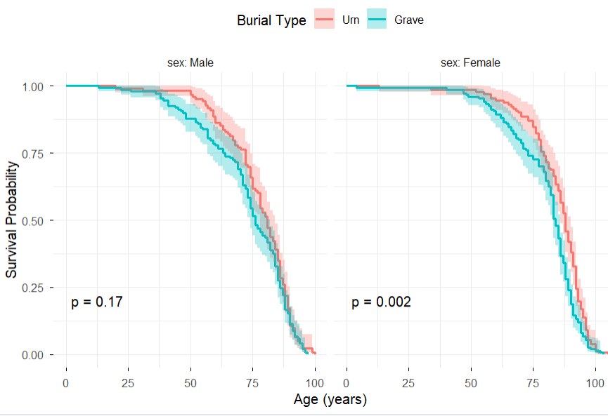
Survival Curve by Sex
Male
Female
In Men
HR = 1.17 [0.92 - 1.49]
In Women
HR = 1.44 [1.13 - 1.82]

Slide 12
Discussion
Finding: Burial in the urn columbarium is associated with longer overall survival than a burial in the grave plot
Interpretation: Cause unclear, could reflect cultural, religious, or cohort effects
Open question: What is your hypothesis, and what additional data would be needed to test it?

Slide 13
Socioeconomic Status & Survival
Jasmin Dönicke
Max Jaber
Lisa Kannenberg
Andrei Kachmazov

